Slide 1
Model Training

Slide 2
Dataset
Features:
-'lap': Current lap number
'lap_position': What’s the current position of the driver
'Lap_time': time taken to complete the last lap
'Quali_position': result of Qualifiers
'q1', 'q2', 'q3', : time during qualifiers 1,2,3
'No_of_stops': number of pit stops taken on previous laps
'Pit_stop_duration': latest pitstop duration
'Total_laps' : total laps to complete the race
Target : 'total_time' time to complete the race

Slide 3
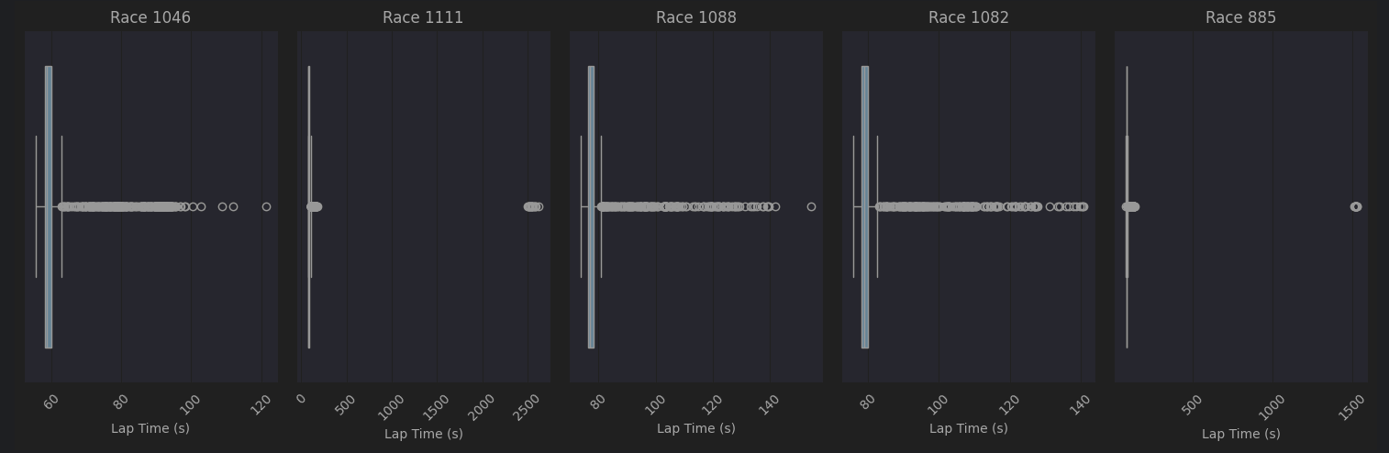
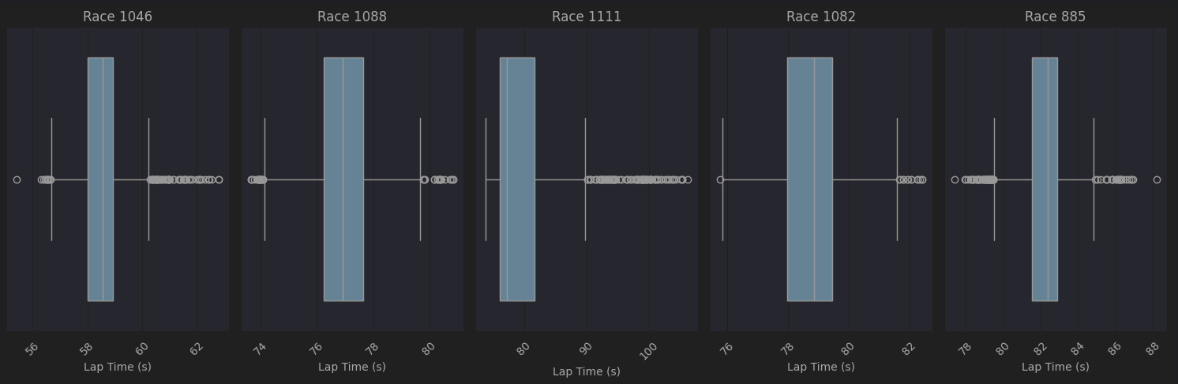
Handling Outliers
Lap time:
When randomly plotting race-specific lap times, extreme outliers are observed. Instead of removing these lap time observations, they are imputed with the median lap time of that driver during the race.

Slide 4
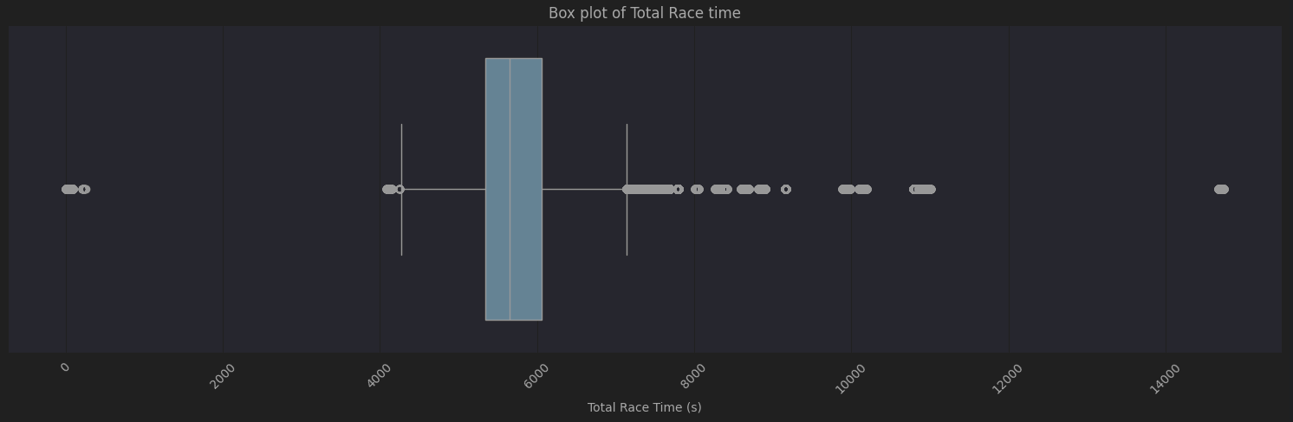
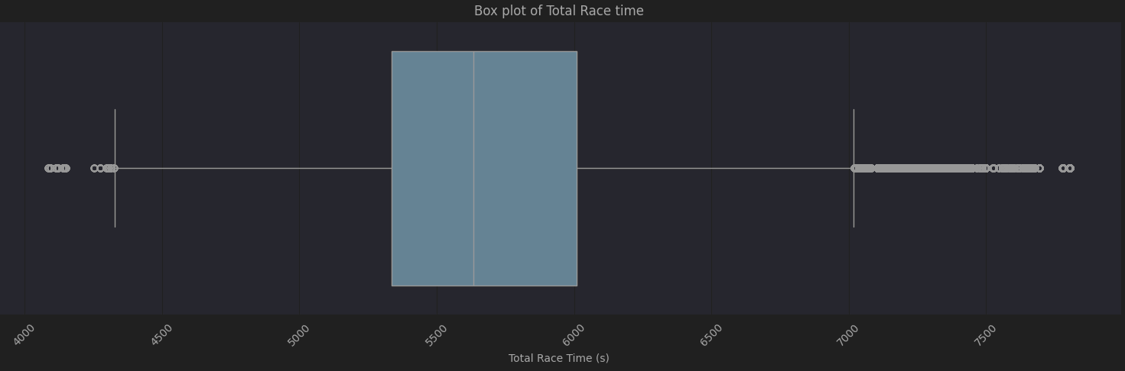
2. Total Race time
There were a few unrealistic total race times. Therefore, times greater than 8000 seconds and times less than 4000 seconds were removed from the dataset.

Slide 5
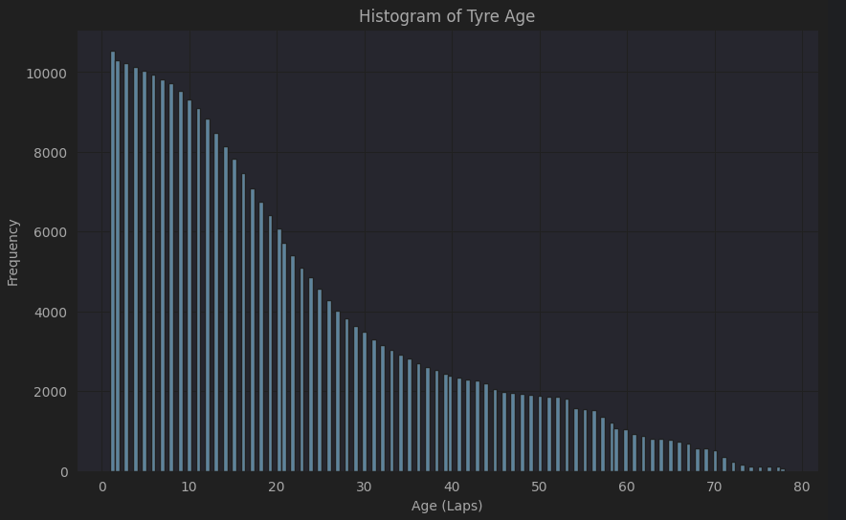
Creating a new feature -Tyre Age
Since the tyre age was not provided by the dataset and for F1 racing the age of tyre plays a pivotal role in predicting the total time taken to complete the race using the current lap status. So the tyre age at the particular lap is calculated using the last time when the driver took a pit stop.

Slide 6
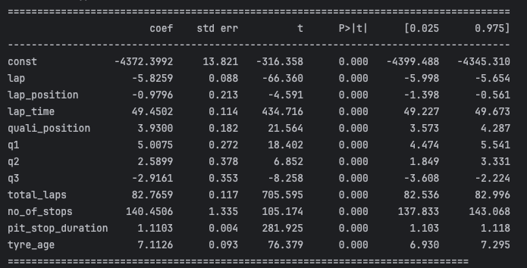
Feature Selection - OLS
Constant (Intercept): The constant is -4372.3992, meaning that the baseline total race time is -4372 seconds (which isn't directly interpretable but helps set the reference point for all other variables).
lap: The coefficient for lap is -5.8259, indicating that with each additional lap, the total race time decreases by approximately 5.83 seconds. This is statistically significant (t = -66.360, p-value = 0.000).
lap_position: The coefficient for lap position is -0.9796, suggesting that with each additional lap position, the total race time decreases by 0.98 seconds. This is also statistically significant.
lap_time: The lap time coefficient is 49.4502, meaning that for each second added to the lap time, the total race time increases by approximately 49.45 seconds.
quali_position: A positive coefficient of 3.9300 means that the higher the qualifying position, the longer the total race time is expected to be.
q1, q2, q3: These features represent the qualifying times in each of the three qualifying rounds, and their coefficients reflect their impact on race time:
q1: Positive effect, indicating faster qualifying times lead to longer race times.
q2: Positive effect, but weaker than q1.
q3: Negative effect, indicating slower qualifying times lead to longer race times.
total_laps: A very strong positive effect (82.7659), suggesting that each additional lap increases the total race time significantly.
no_of_stops: A positive coefficient of 140.4506, meaning each additional pit stop increases the total race time by about 140.45 seconds.
pit_stop_duration: Each second spent in the pit stop adds approximately 1.11 seconds to the total race time.
tyre_age: The coefficient of 7.1126 indicates that as the tyre age increases by one unit, the total race time increases by about 7.11 seconds.

Slide 7
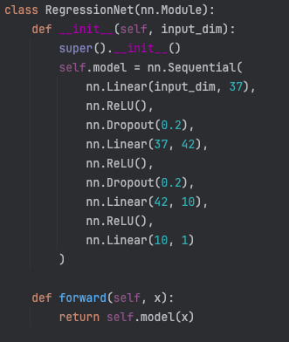
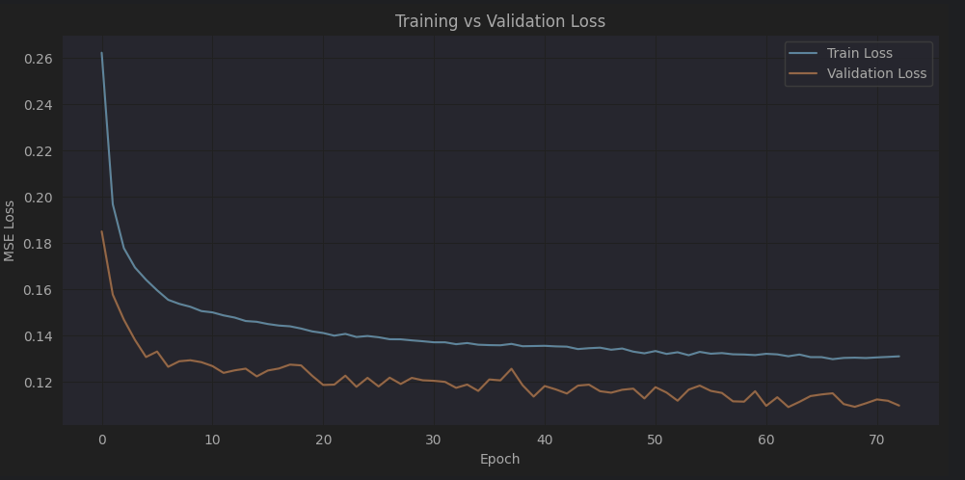
Model 1 - Deep Neural Network
Loss : MSE
Train_loss = 0.13
val_loss = 0.12
Test:
MSE : 0.49
MAE: 0.45
R square: 0.6467

Slide 8
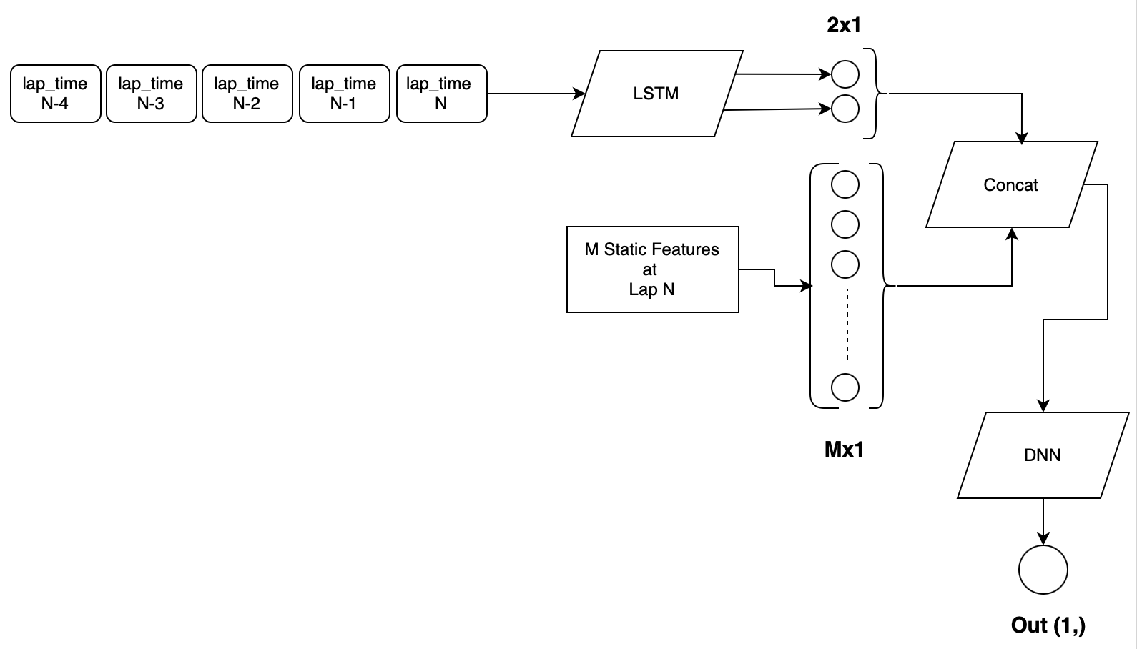
Model 2 : LSTM + DNN
To predict total race time based on driving history, we designed a hybrid LSTM-based architecture. The model processes the previous 5 lap_time values using an LSTM, producing a 2-dimensional latent representation. This representation is concatenated with static features (same as the previous model) and passed through a shallow feedforward neural network to predict the total time.
Key Advantage:
This architecture captures both temporal dynamics (via LSTM for lap history) and contextual race features (via static input), improving prediction accuracy over models that treat laps independently.

Slide 9
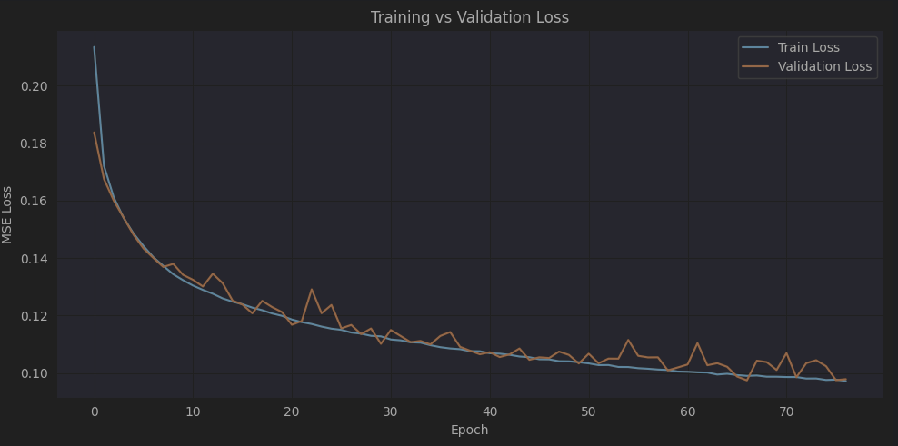
Loss : MSE
Train_loss = 0.0972
val_loss = 0.0978
Test:
MSE : 0.1124
MAE: 0.2381
R square: 0.9192

